Slide 1
Capacity Management Tool
Define text based data collection process

Slide 2
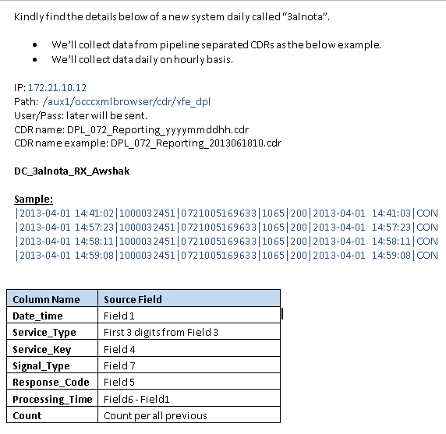
Data collection process specifications

Slide 3
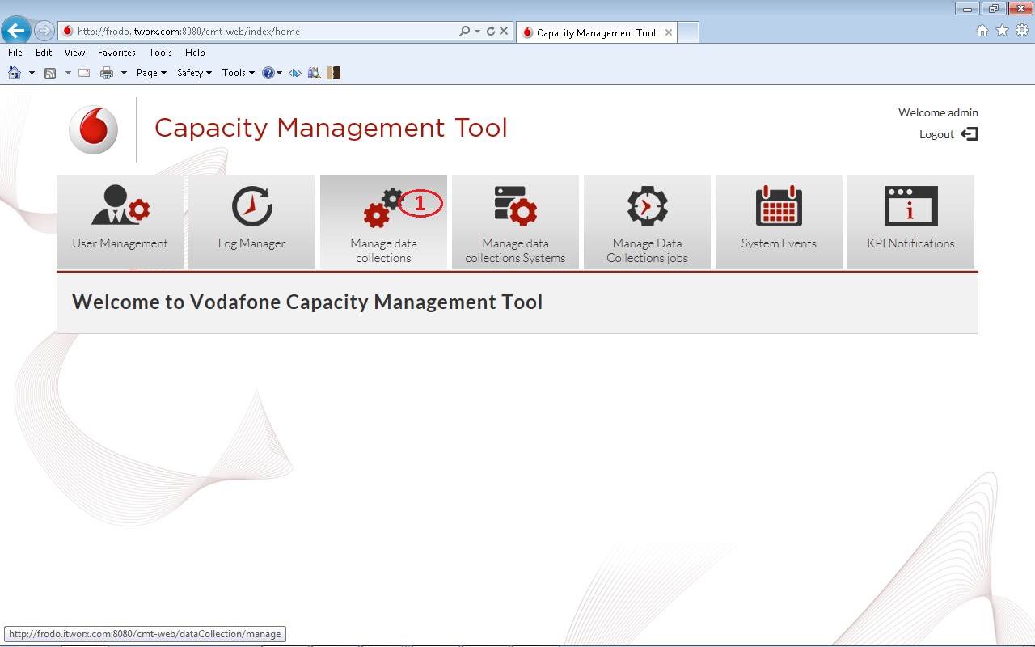
Open the “Define New data collection” wizard
Click the “Manage Data Collections“ Tab

Slide 4
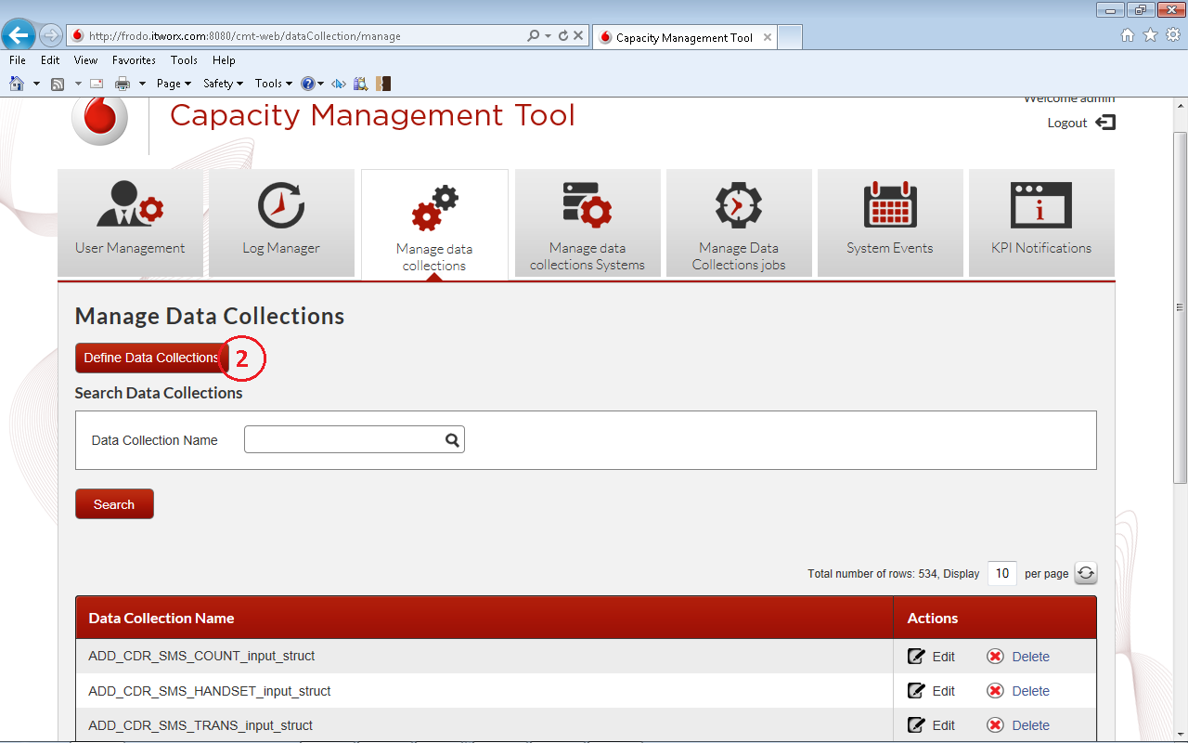
Open the “Define New data collection” wizard
Click “Define Data Collection“ Button

Slide 5
Step1:
Select data collection type

Slide 6
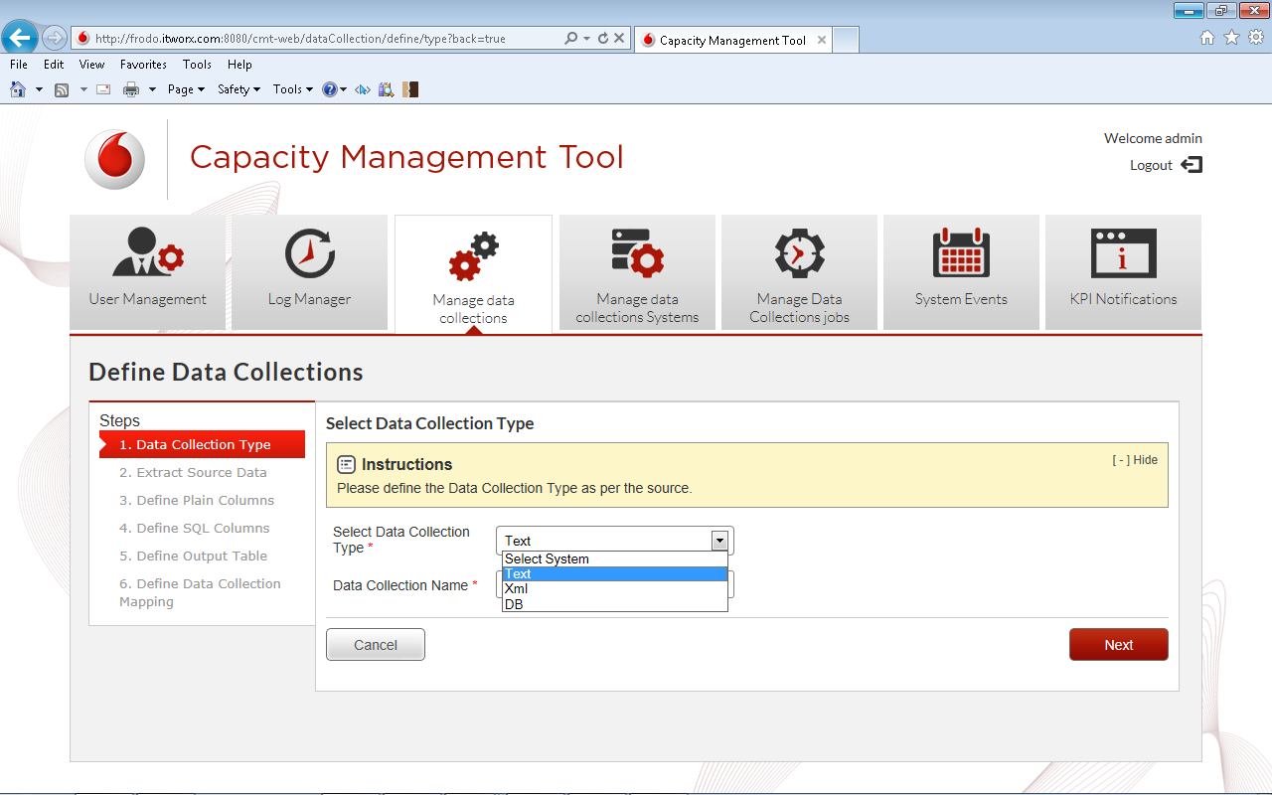
Step1: Select Data Collection type
1
Select type text

Slide 7
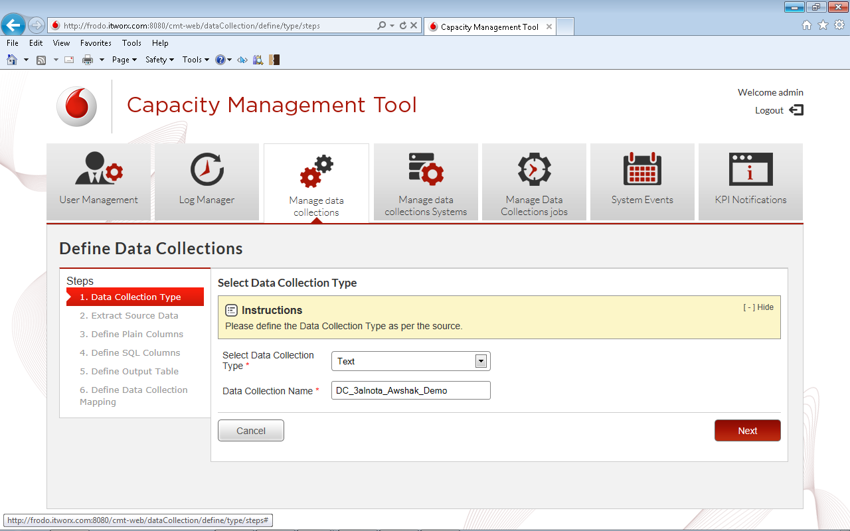
Step1: Select Data Collection type
2
Type data collection name
Next Step

Slide 8
Step2:
Extract source data

Slide 9
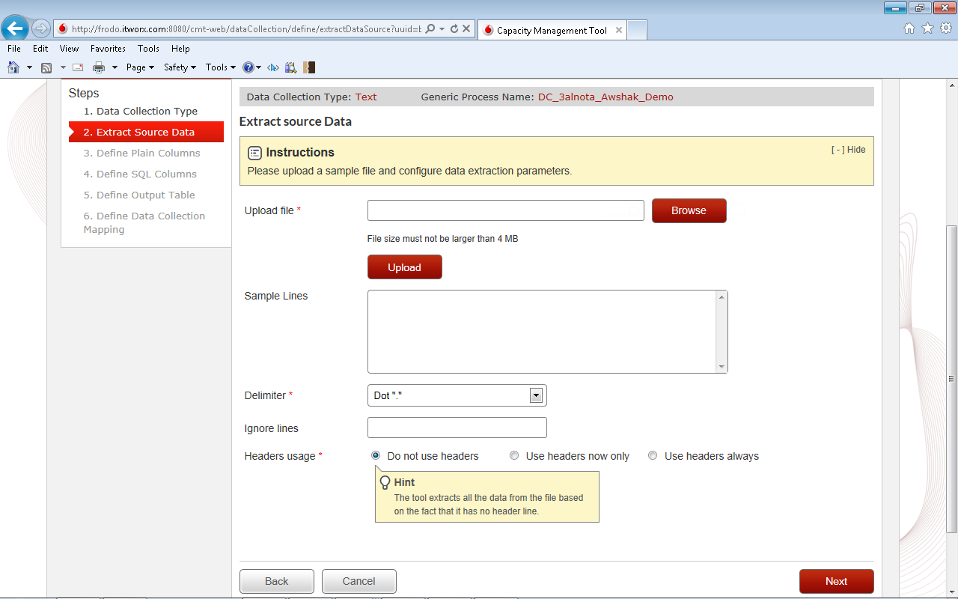
Step2: extract source data
1
Brows sample file
2
Click upload
Sample file contents appear here

Slide 10
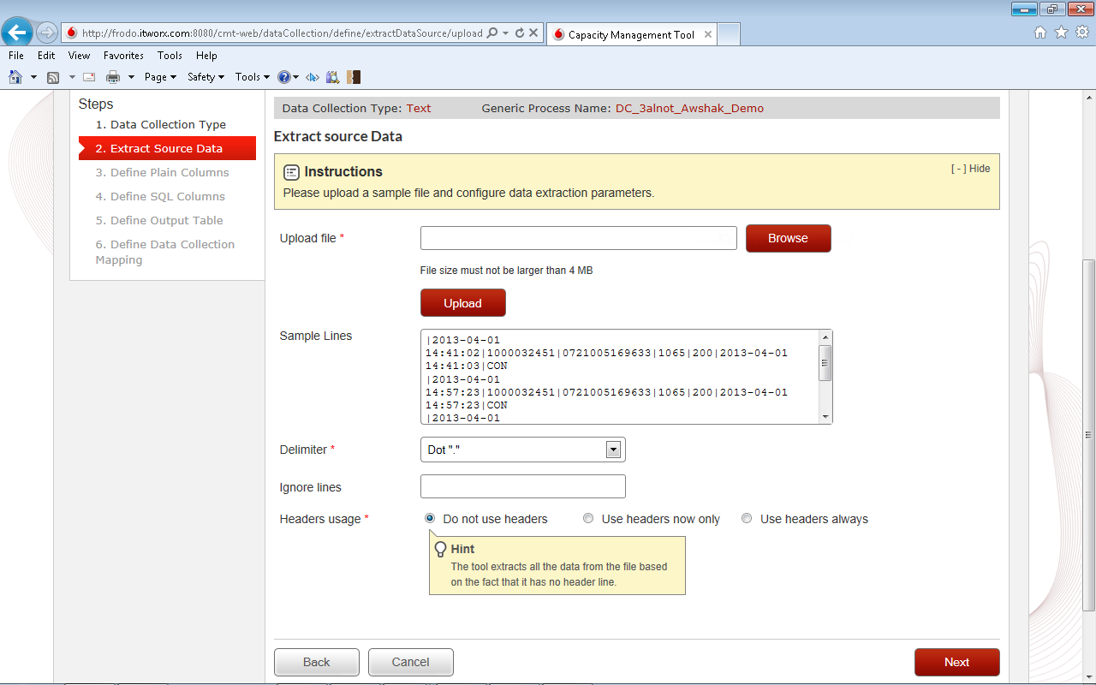
Step2: extract source data

Slide 11
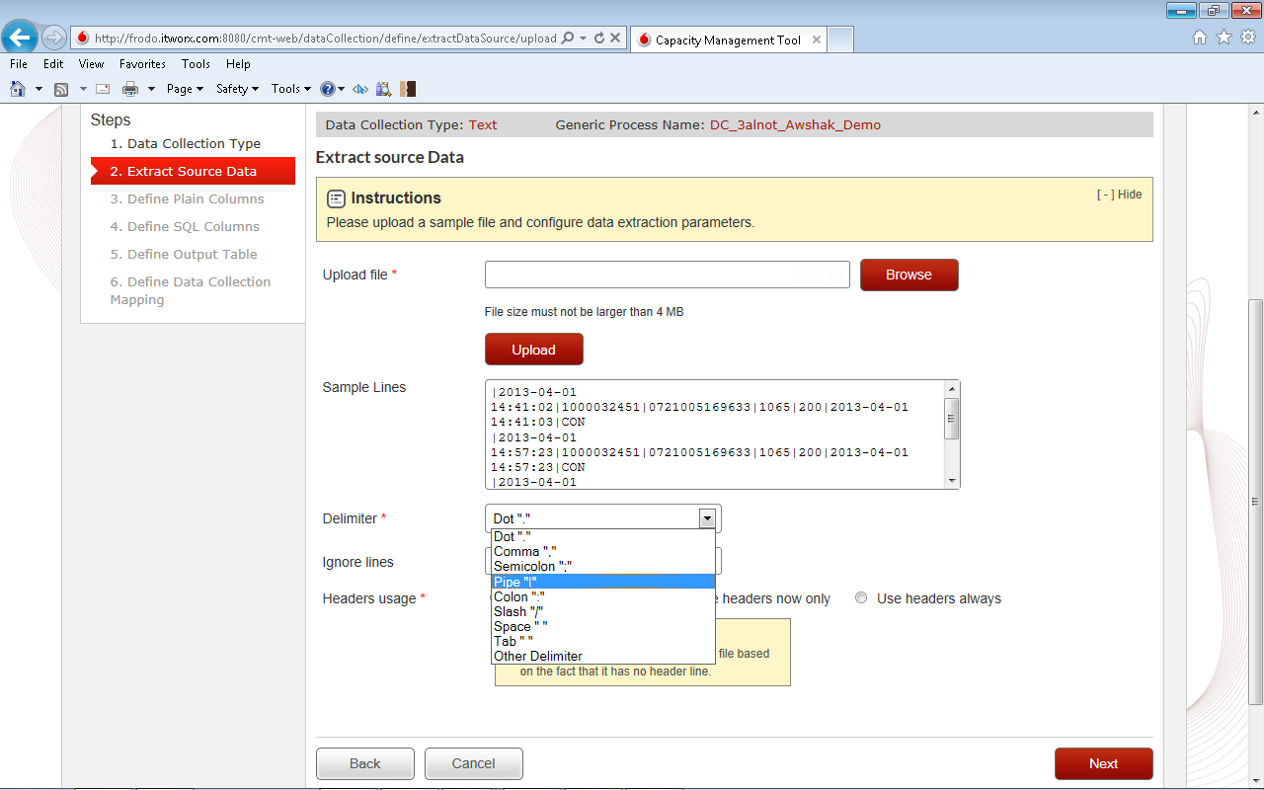
Step2: extract source data
3
Select Delimiter

Slide 12
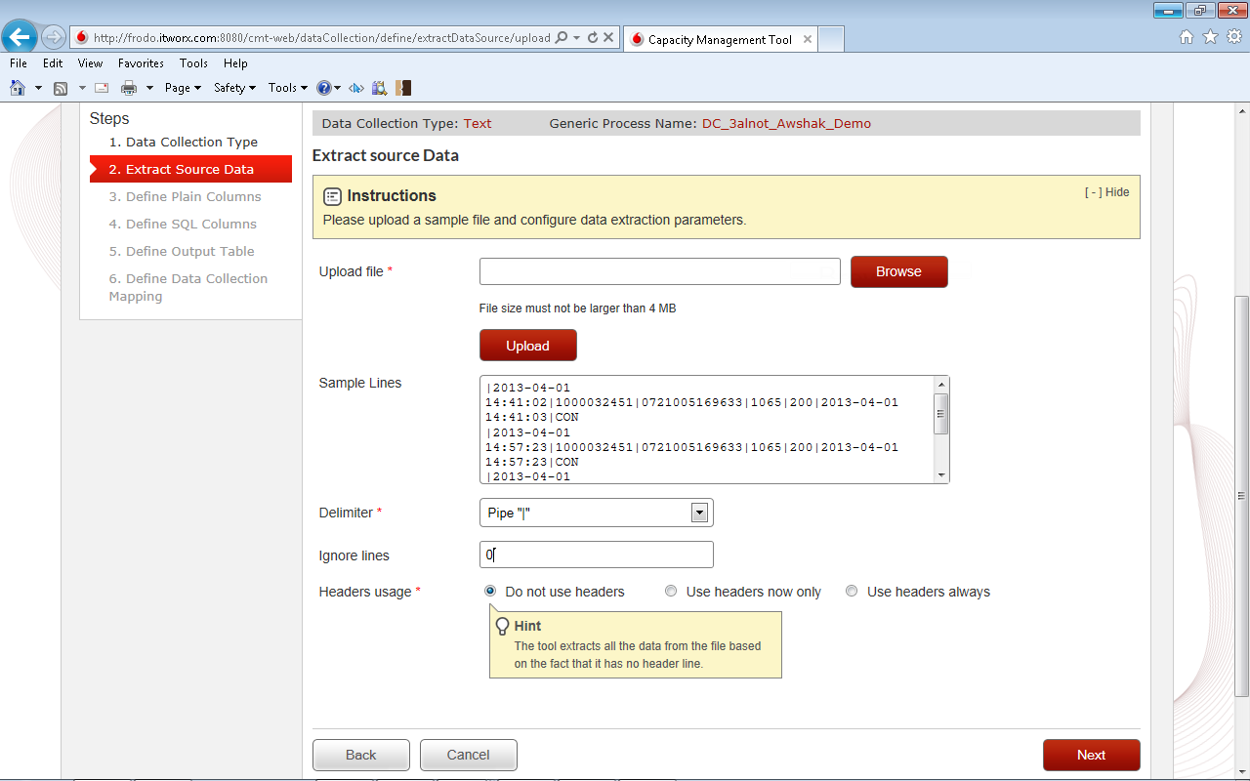
Step2: extract source data
4
Input ignore lines count if any
5
Select appropriate Header usage option
Next Step

Slide 13
Step3:
Define plain colums

Slide 14
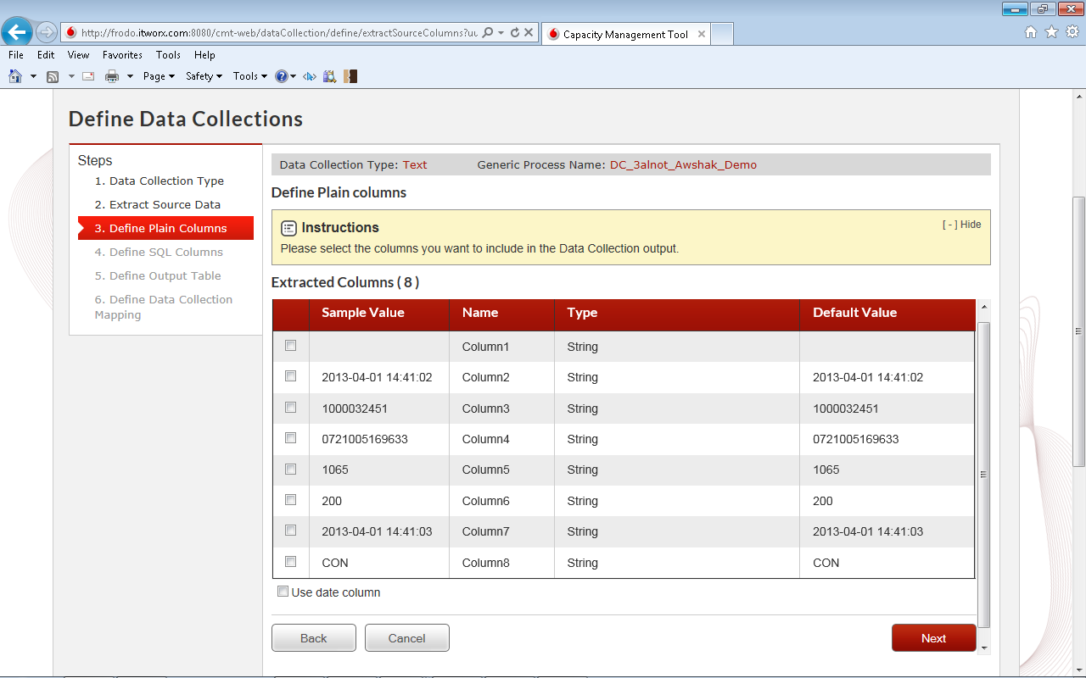
Step3: define plain columns

Slide 15

Step3: define plain columns
Select columns

Slide 16
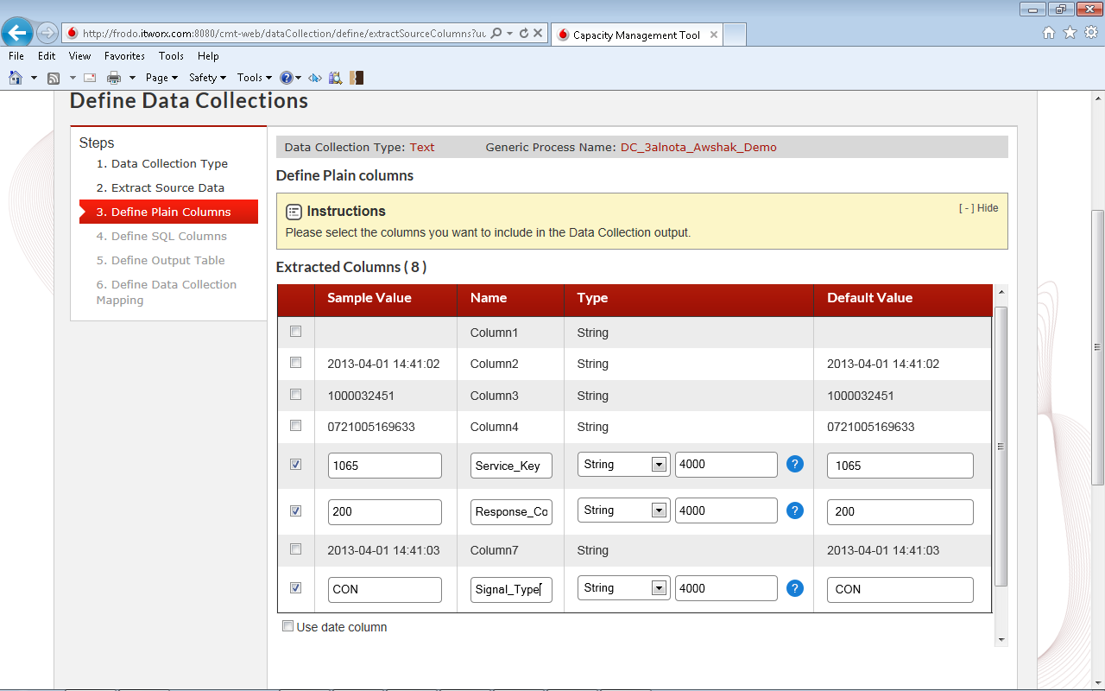
Step3: define plain columns
Edit columns names

Slide 17

Step3: define plain columns
Edit columns types

Slide 18
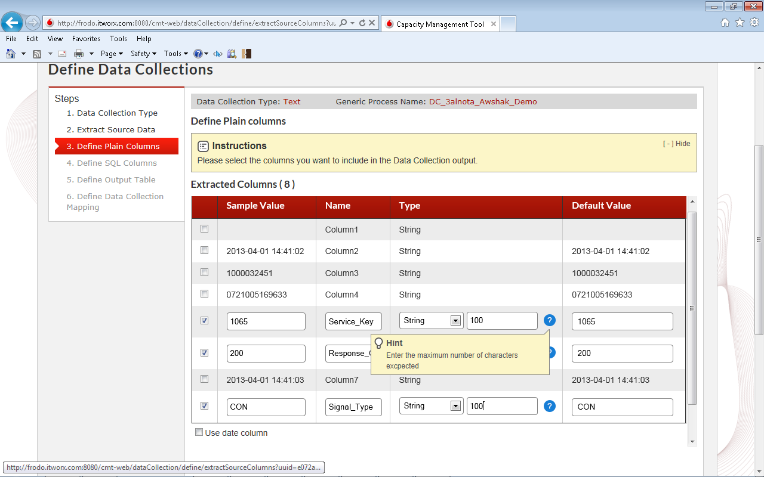
Step3: define plain columns
Set String Length (Utilized space usage)

Slide 19
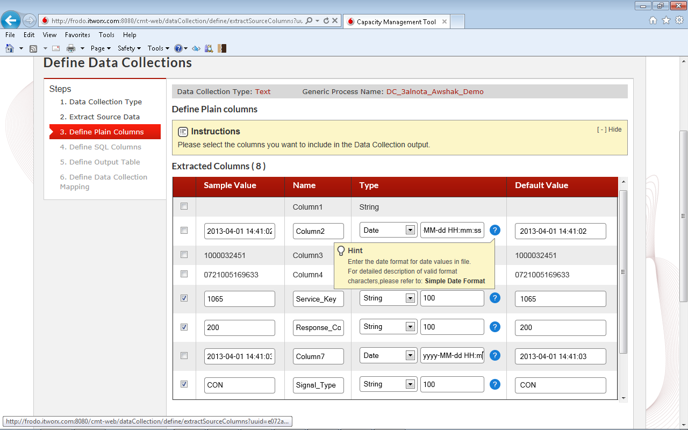
Step3: define plain columns
Set Date format (Support wide range of formats)

Slide 20
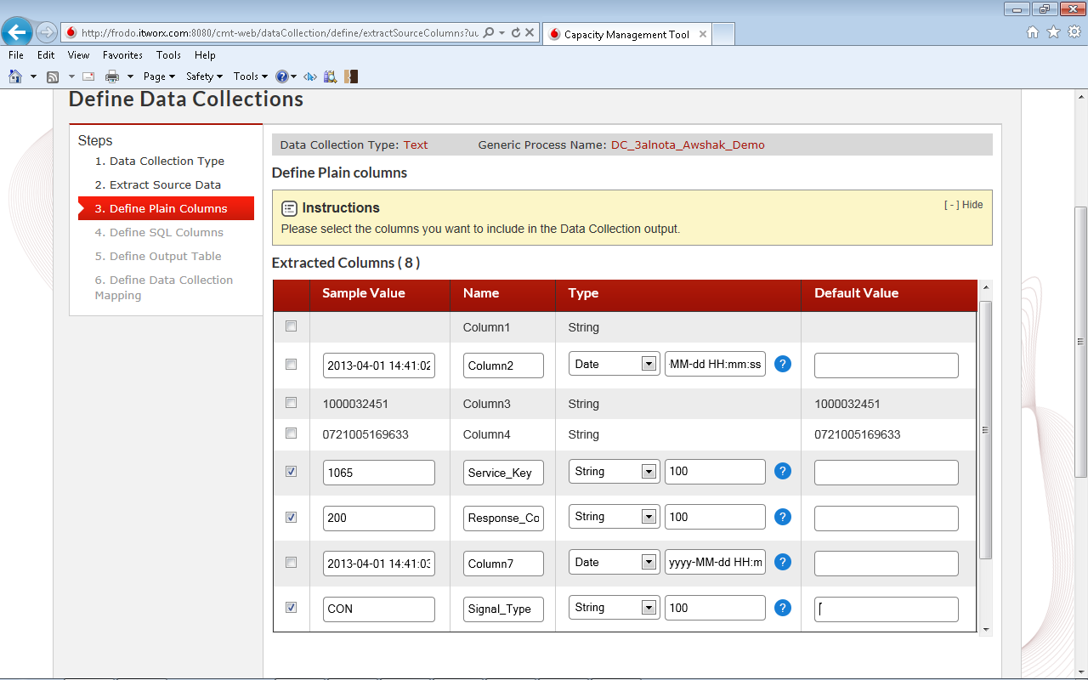
Step3: define plain columns
Edit Default values, or just provide no default value

Slide 21
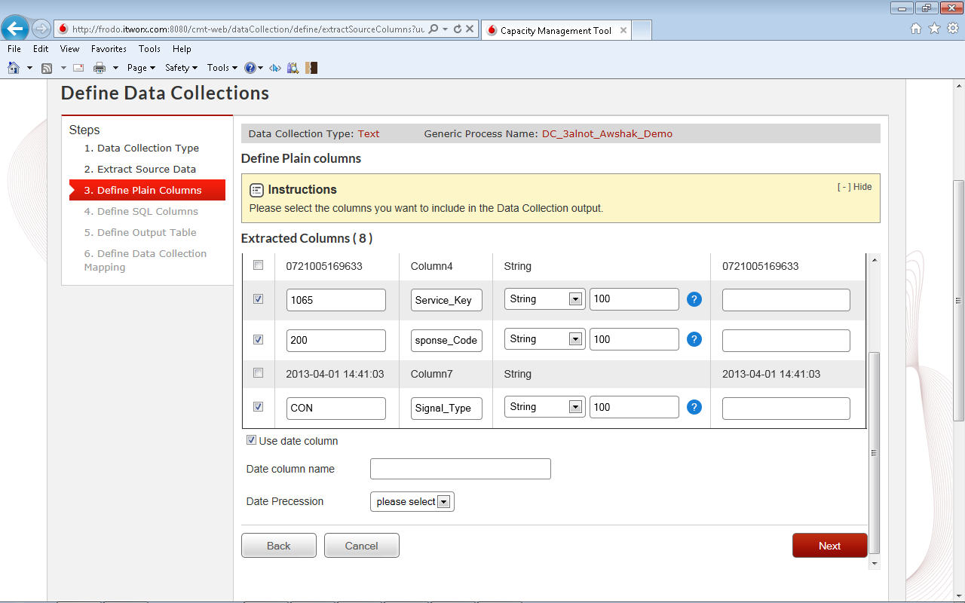
Step3: define plain columns
Add Date Filtration for File Data.

Slide 22
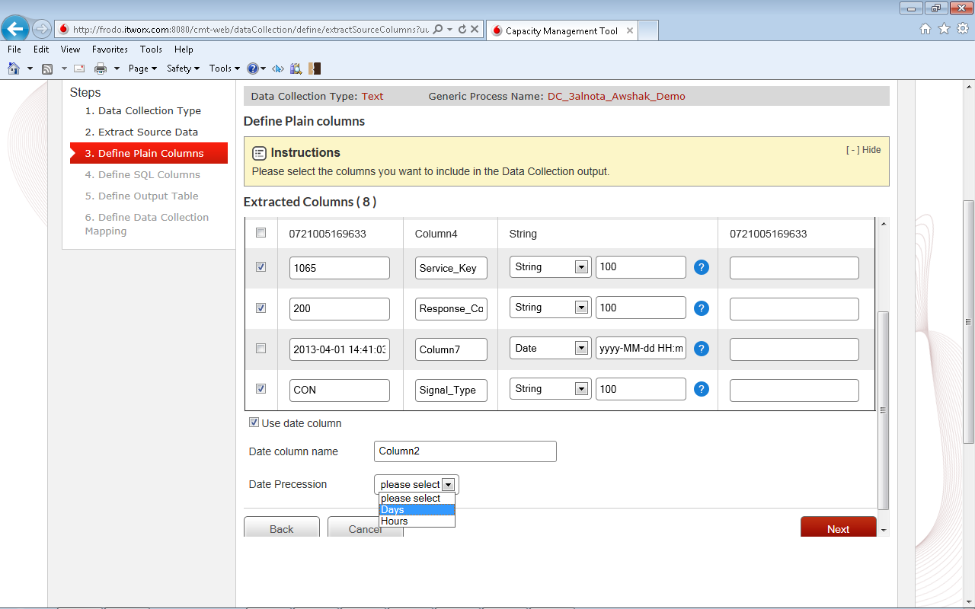
Step3: define plain columns
Support collecting data on ‘Daily‘ Or ‘Hourly’ bases

Slide 23
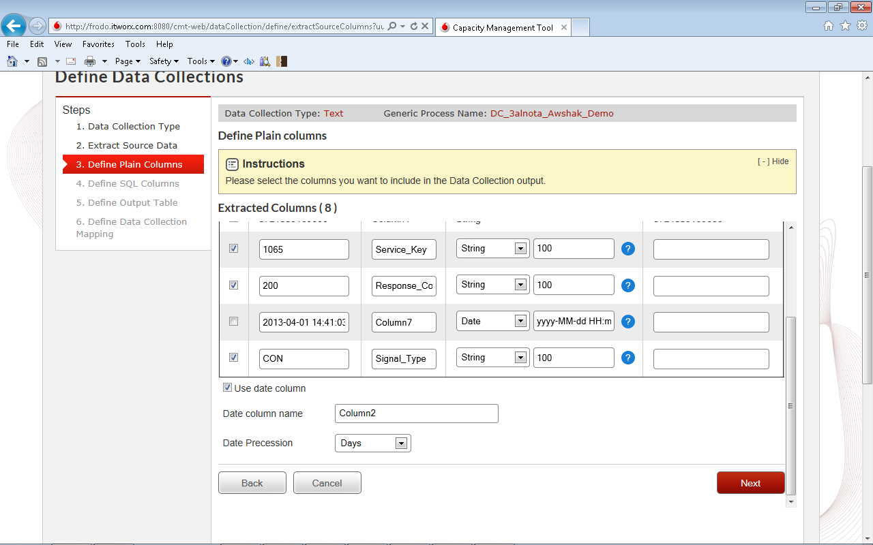
Step3: define plain columns
Next Step

Slide 24
Step4:
Define SQL columns

Slide 25
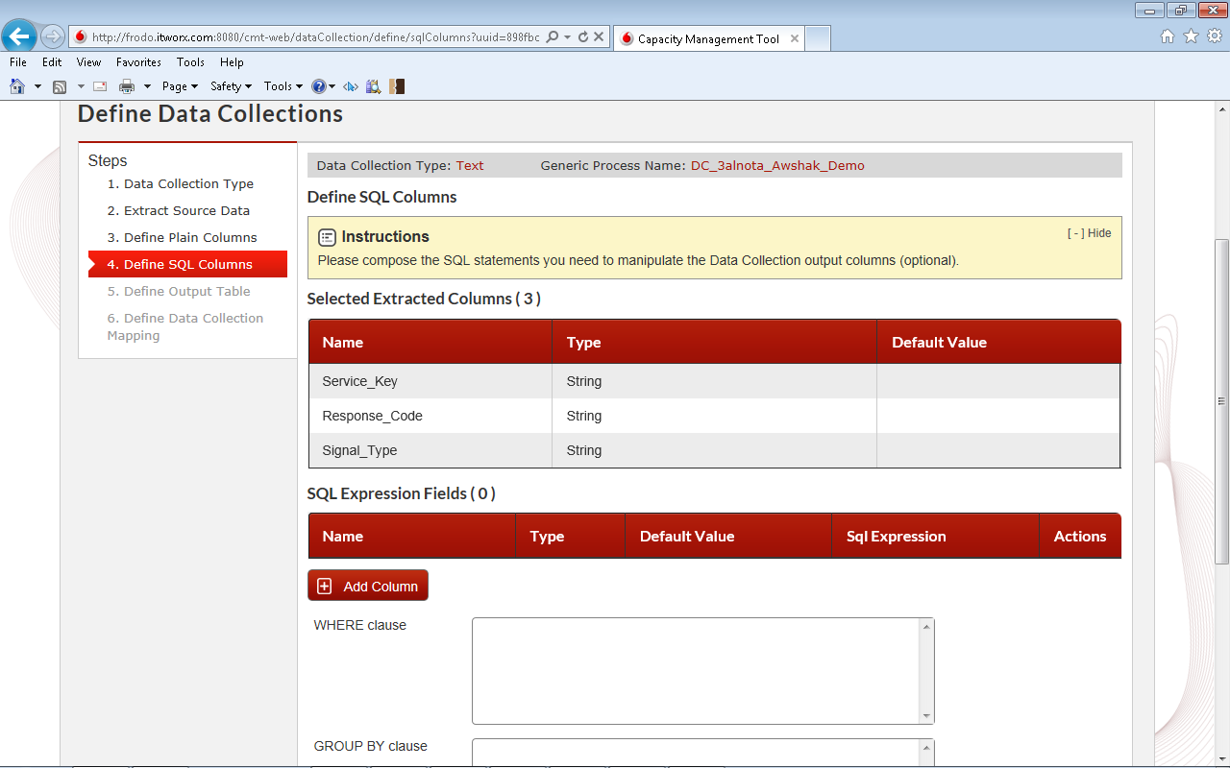
Step 4: define sql columns
Click “Add Column” Button

Slide 26
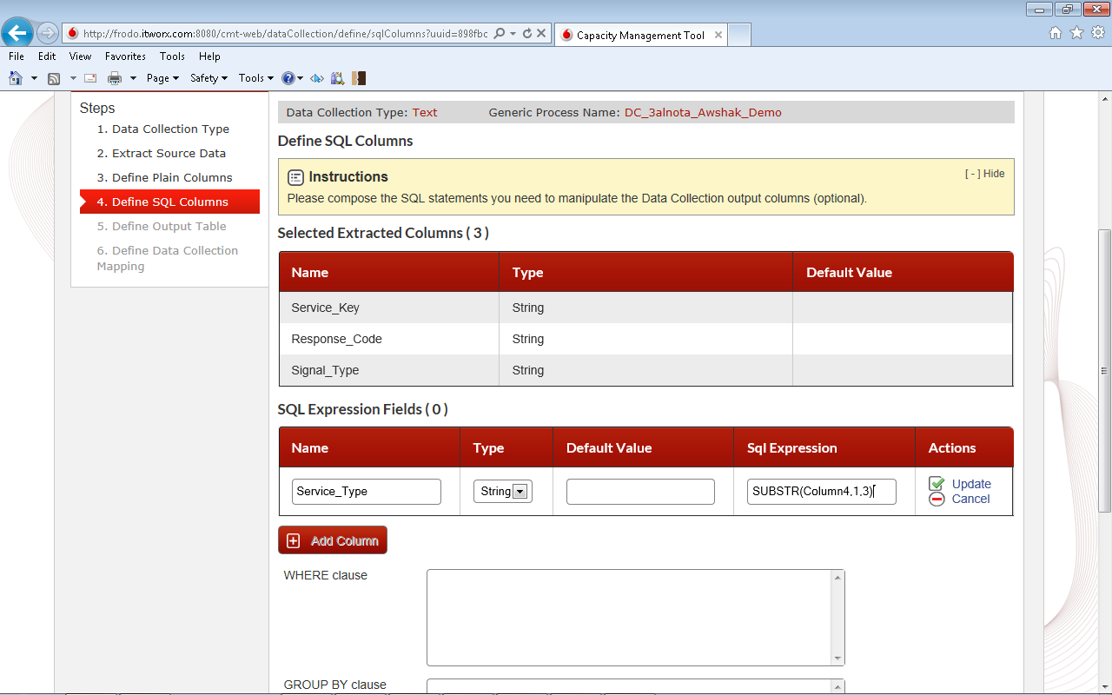
Step 4: define sql columns
Click “Update” icon
Input column name, type, and SQL Expression

Slide 27
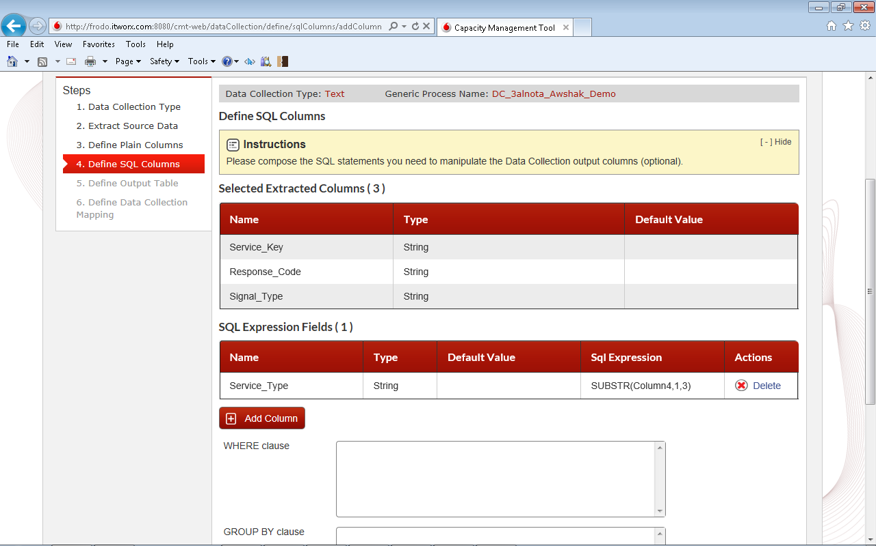
Step 4: define sql columns
Column added

Slide 28
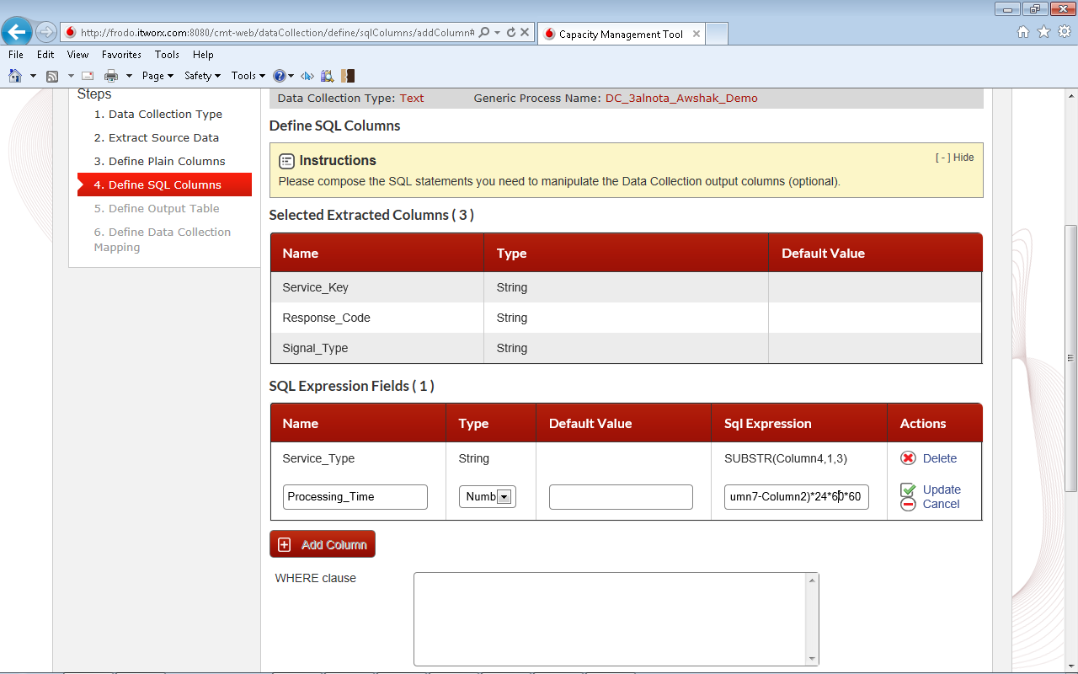
Step 4: define sql columns
Add more Columns

Slide 29
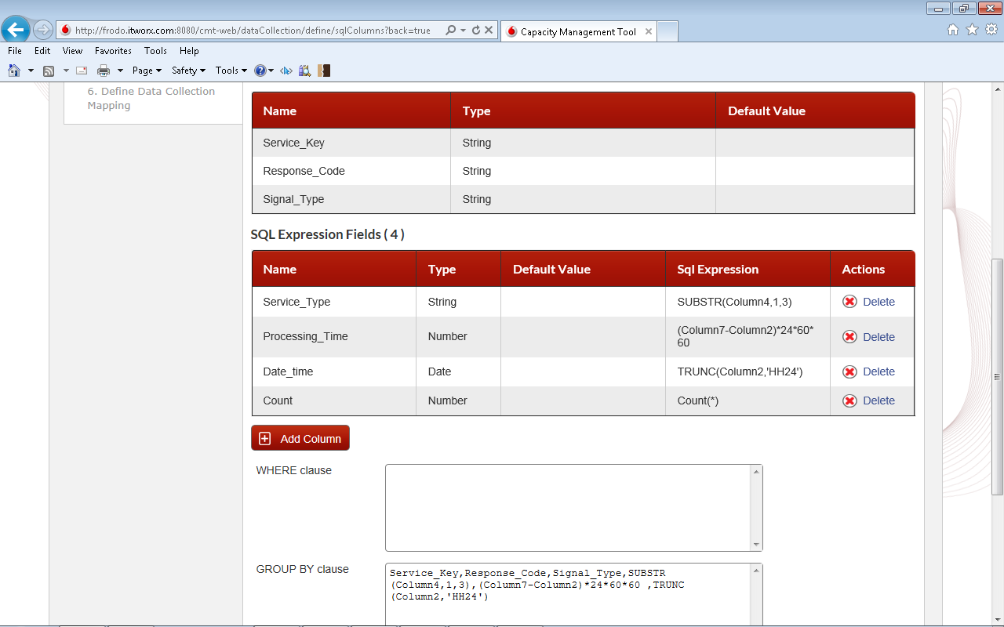
Step 4: define sql columns
Add Group by Clue

Slide 30
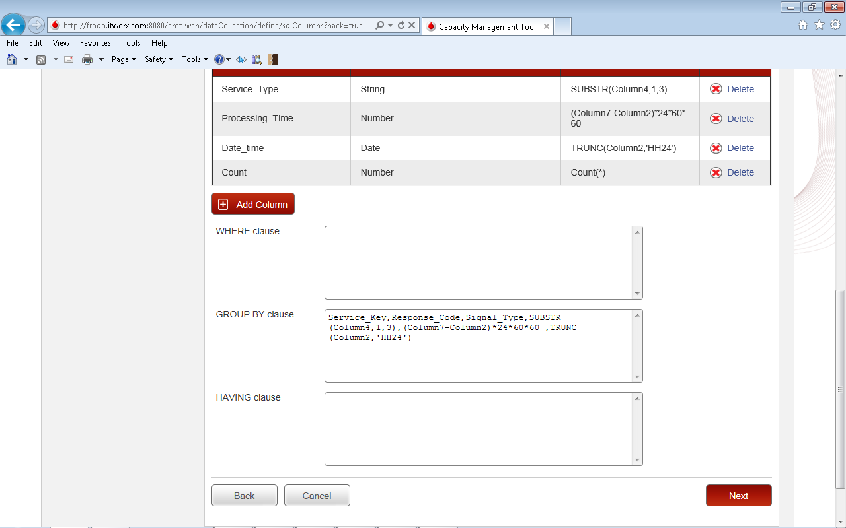
Step 4: define sql columns
Next Step

Slide 31
Step5:
Define output table

Slide 32
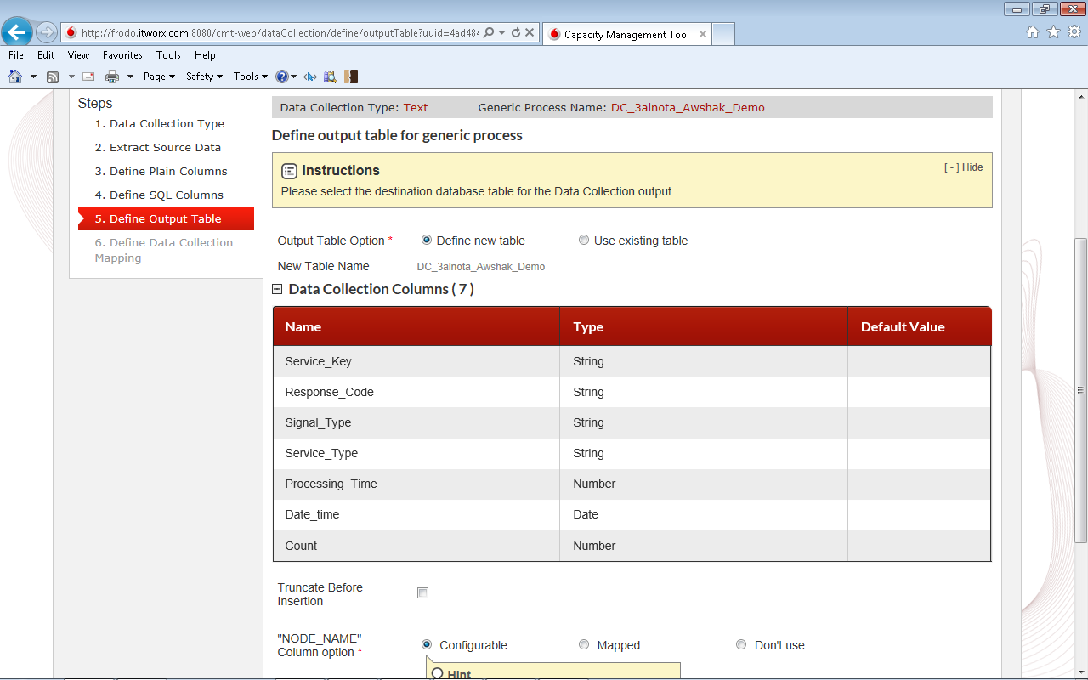
Step 5: define output table
Select “Define new table” option

Slide 33
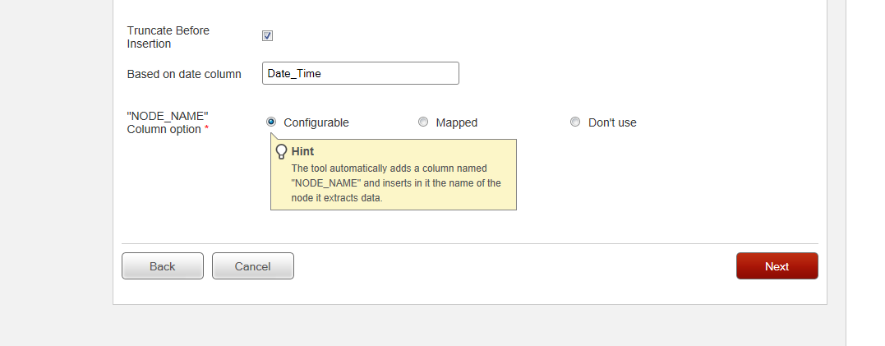
Step 5: define output table
Check “Truncate before insert” to prevent redundant data
Input date column of the output table to delete redundant data based on its value
Select “Configurable” for NODE_NAME column type
Next Step

Slide 34
Step6:
Define data collection mapping

Slide 35
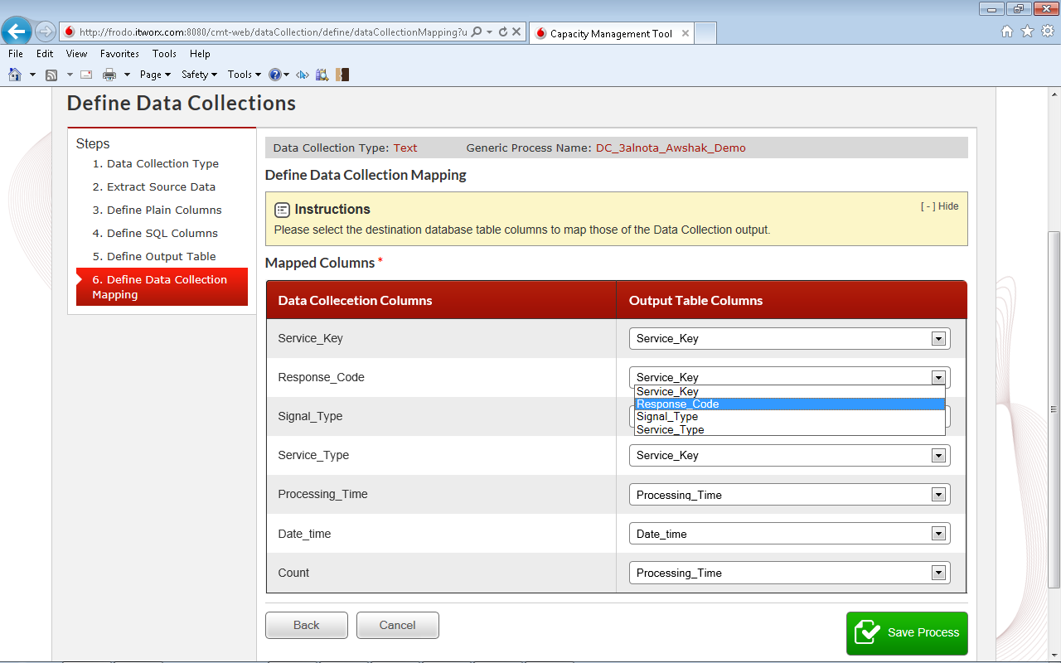
Step 6: define data collection mapping
Showing only matching type columns
Map data collection columns to output table columns

Slide 36
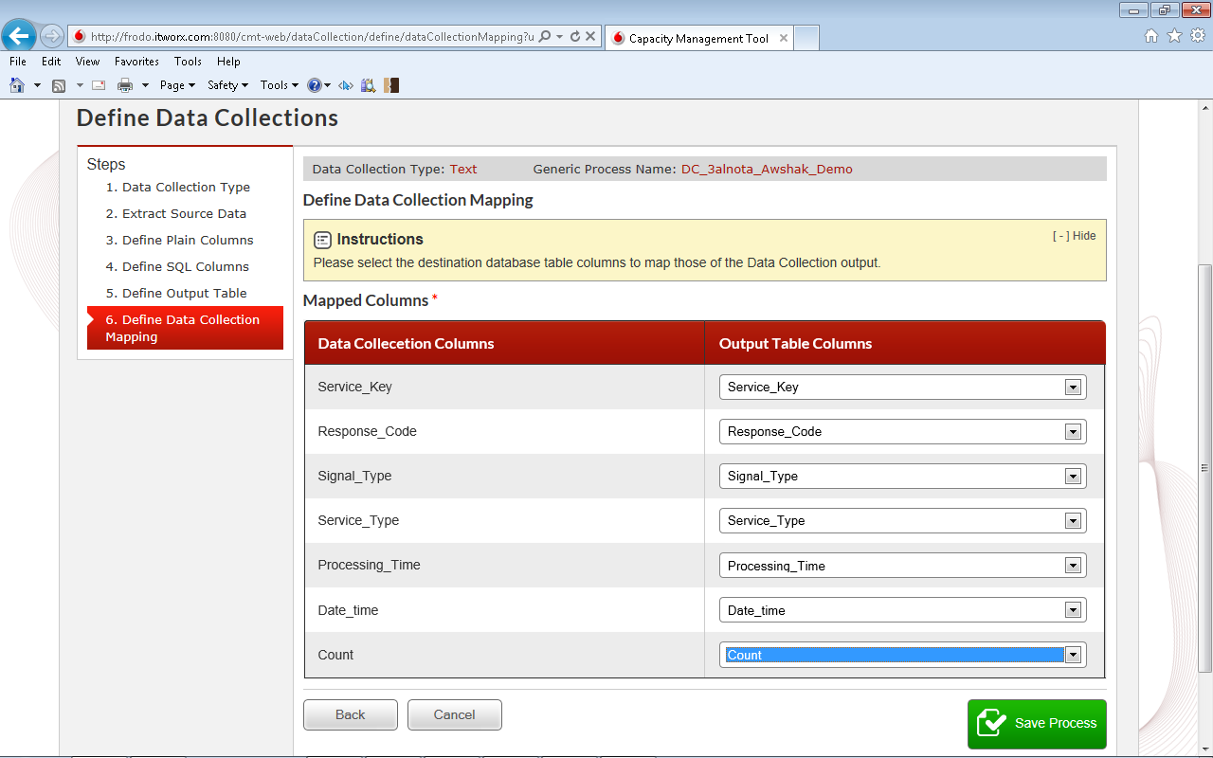
Step 6: define data collection mapping
Last step: Save Process

Slide 37
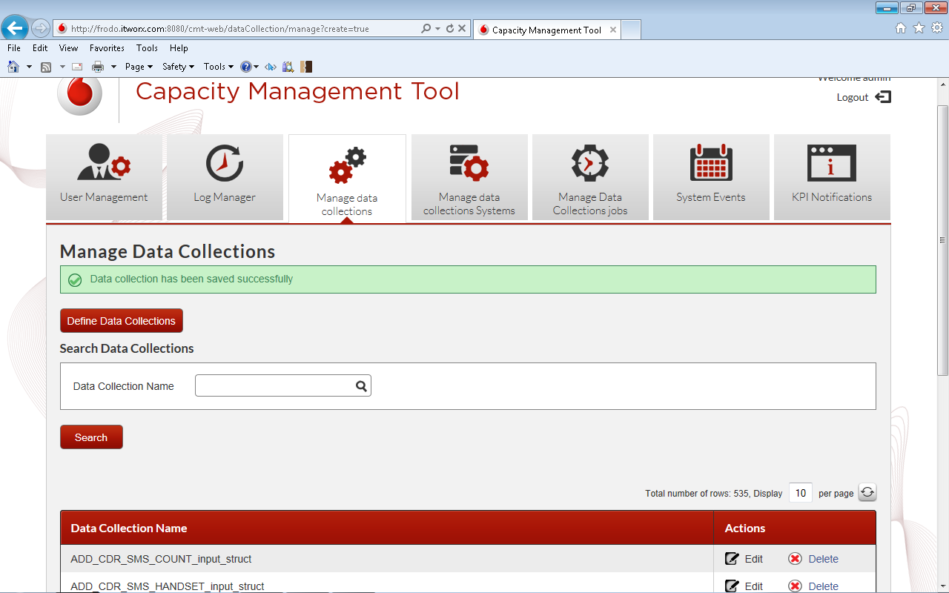
DONE

